Slide 1



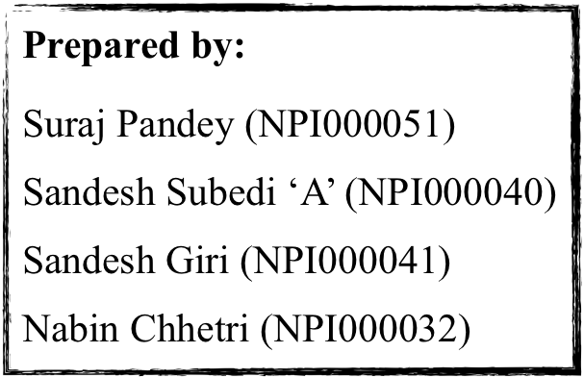
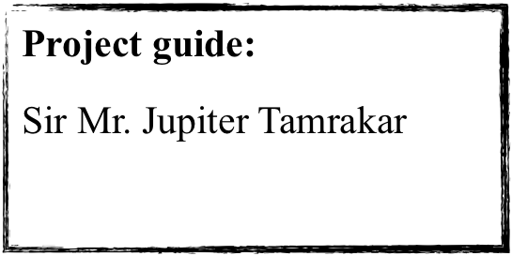
Web Application

Slide 2
Table of content
1
Introduction
E-learning application
Objectives
2
3
Categorisation of audiences
Guest, registered user and Admin
Specification of audience
4
5
Design and modelling
Install Package
ERD,Wireframe and Navigation structure
6
Implementation
Enrol.aspx code
7
Specification of audience
User guidance
Enroll form
8
Conclusion

Slide 3

Introduction
E-learning application
Name of our application is Mind-education
Dynamic web application
Assists user to gain knowledge online
Contain admin and user panel

Slide 4
Objectives
To improve learning and teaching experience
To Create platform where user gets online learning resources
To encounter student’s learning styles and requirements
To share educational resources online
Contain admin and user panel

Slide 5
Categorisation of Audience
Guest - Non Register user
Member- Register User
Admin (System controller)

Slide 6
Specification of Audience
Guest | Student | Admin
Visit system | Register | Register
View Available Courses | login | Login
Register | Edit personal information | View User’s list
 | Enroll | Add course and assignment
 | View Available courses | Aprove enroll request
 | View enrolled courses | View Enroll students
 |  | View and edit profile

Slide 7
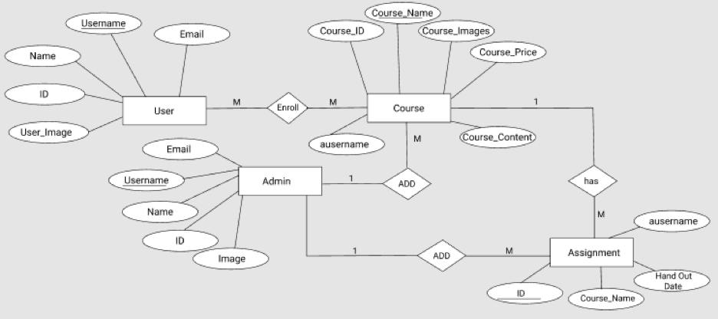
Entity Relationship Diagram

Slide 8
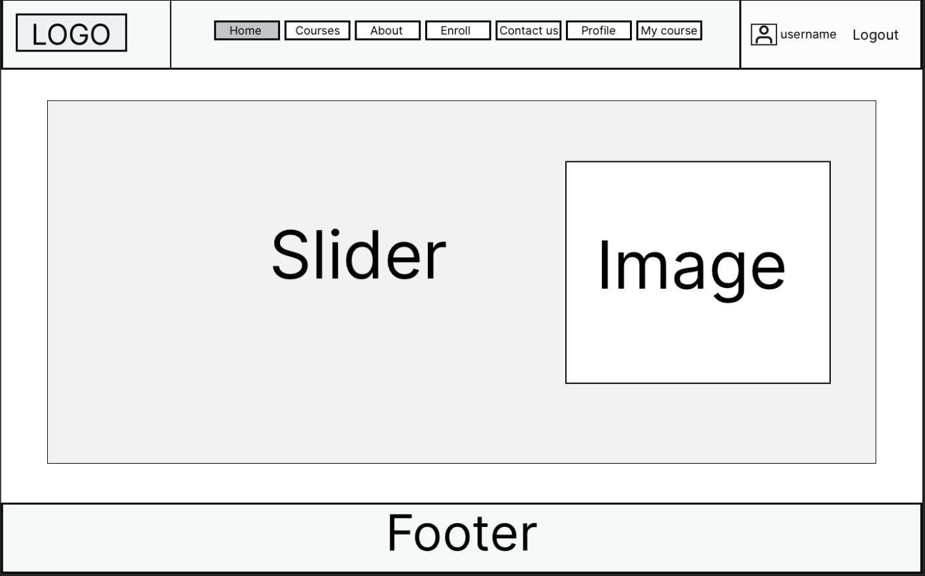
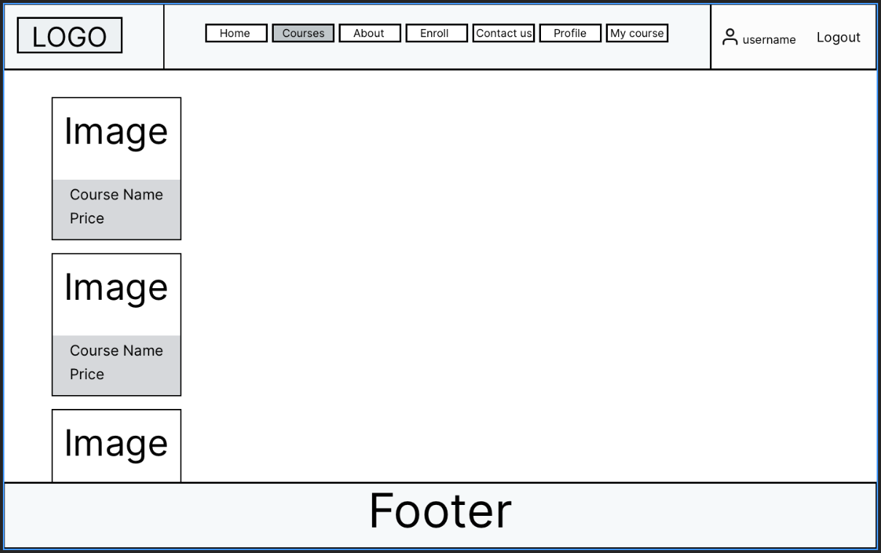
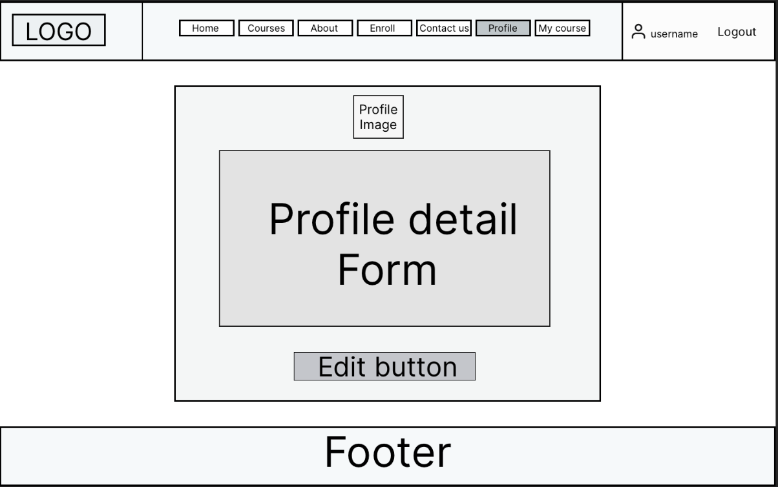
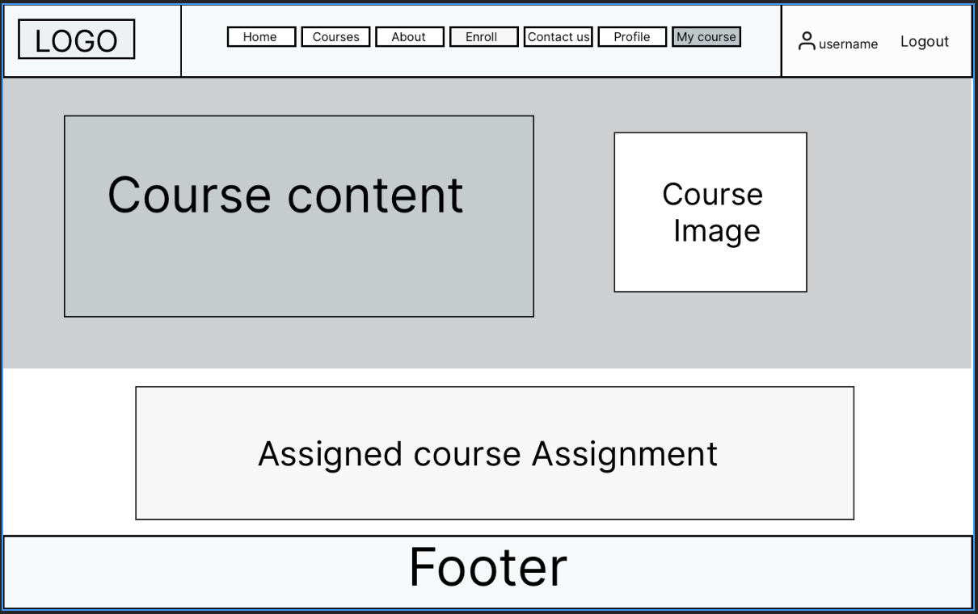
Wire Frame

Slide 9
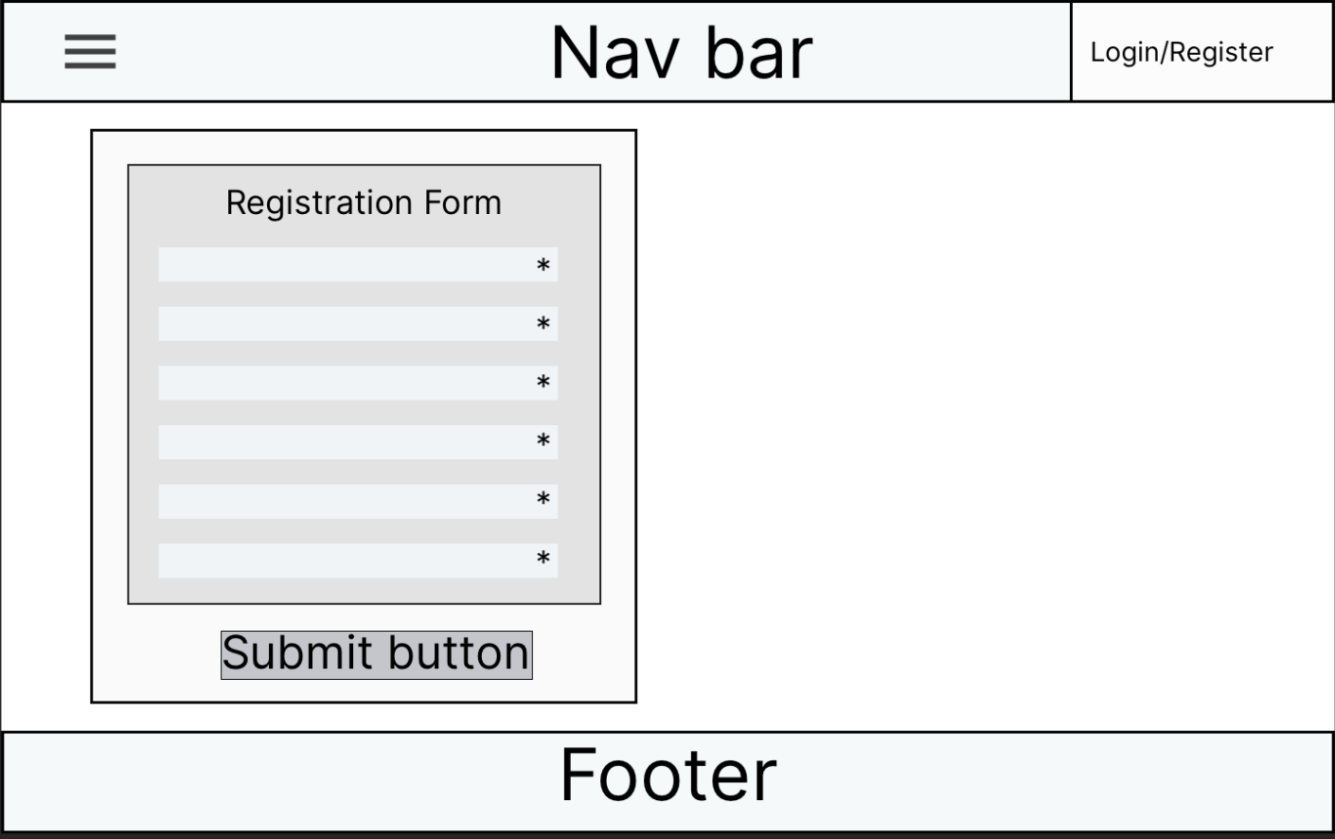
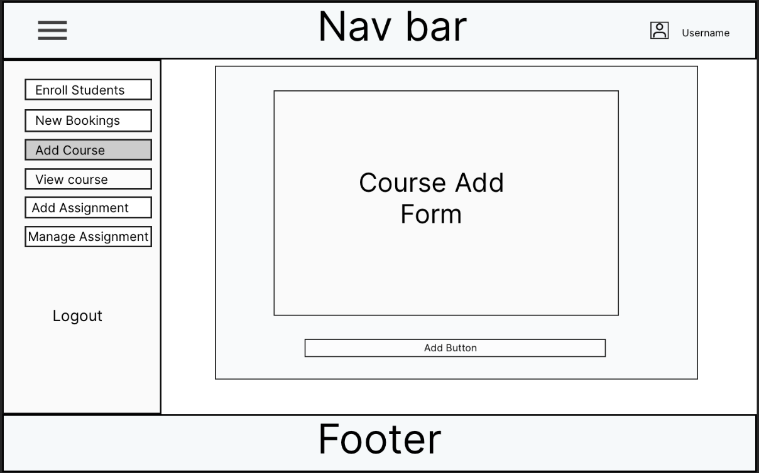
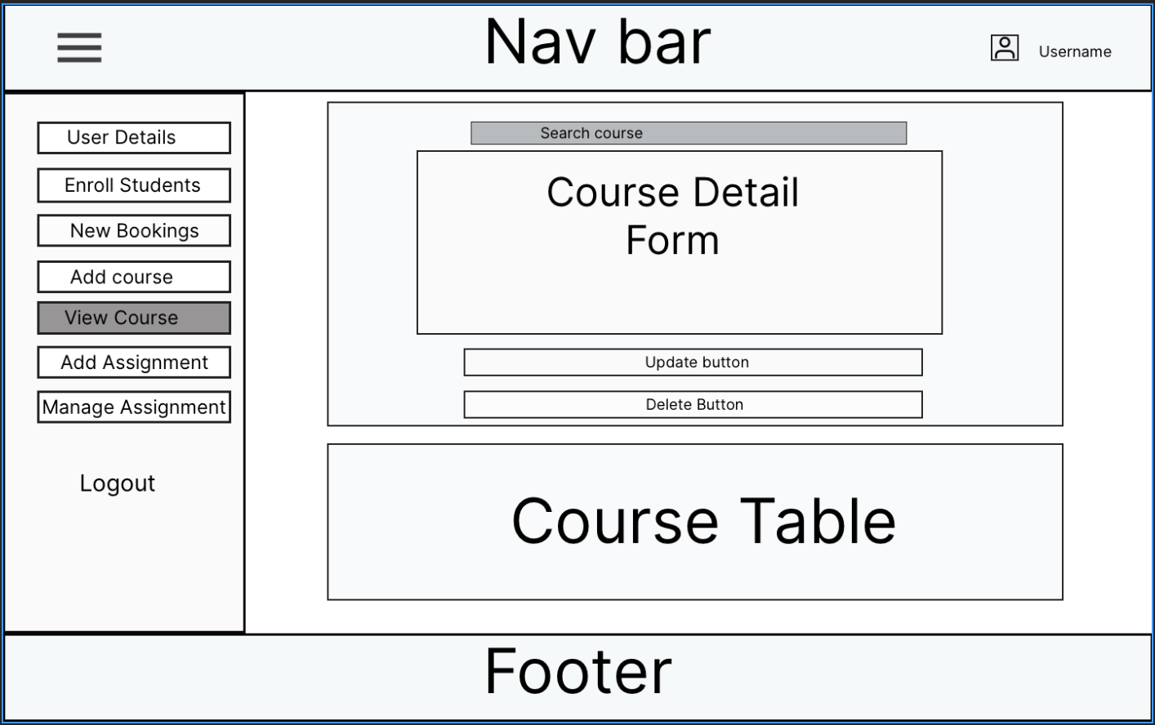
Wire Frame …

Slide 10
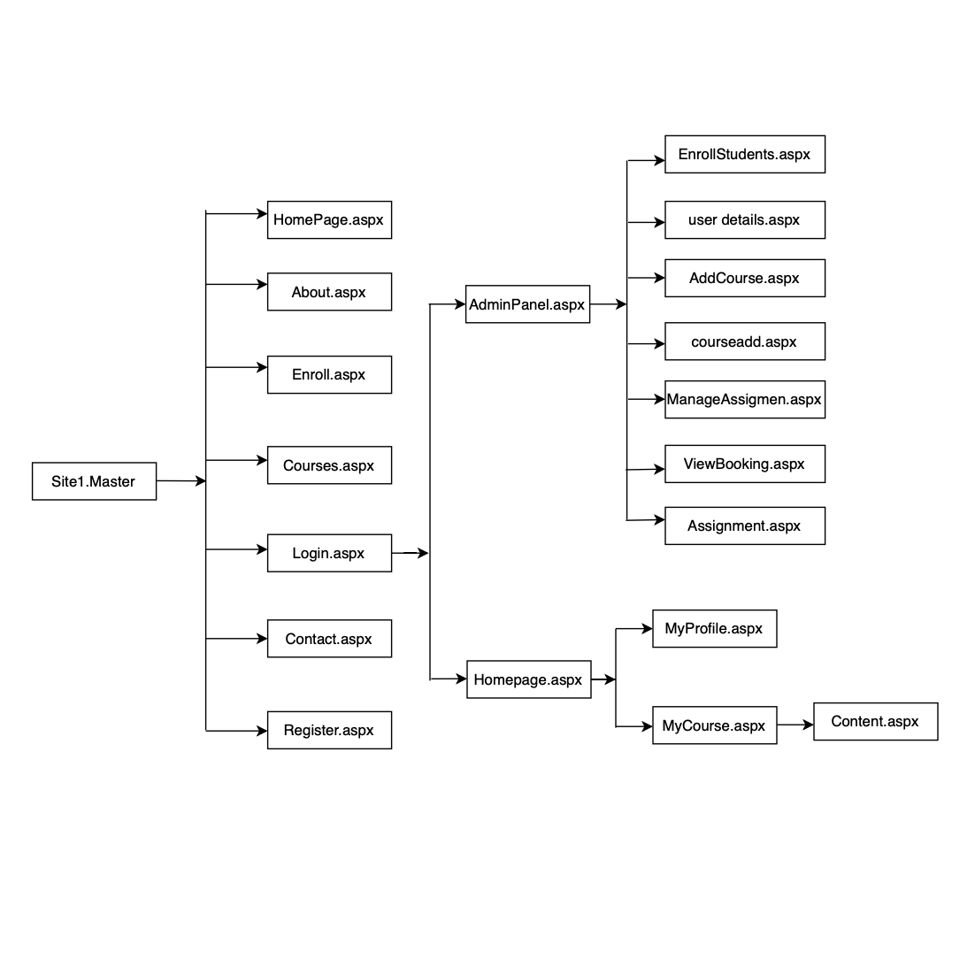
Navigation Structure

Slide 11
Navigation Structure
Static Pages | Dynamic Pages
HomePage.aspx | Register.aspx
About.aspx | Login.aspx
Contant.aspx | Adminregister.aspx
 | Adminlogin.aspx
 | Adminpanal.aspx
 | Adminprofile.aspx
 | Enroll.aspx
 | Myprofile.aspx
 | Mycourse.aspx
 | Courses.aspx
 | Addcourse.aspx
 | Courseadd.aspx( View Course page)
 | Addassignment.aspx
 | Viewassignment.aspx
 | Userdetails.aspx

Slide 12
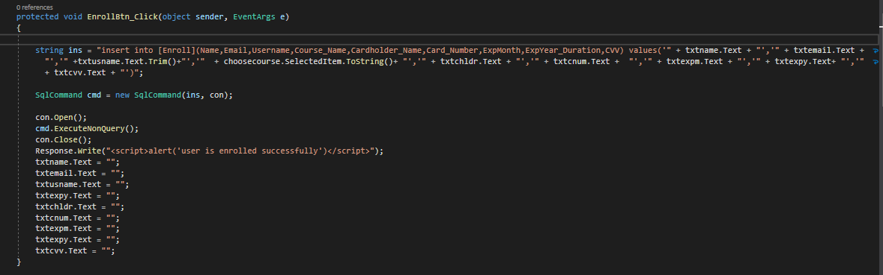
Implementation

Slide 13
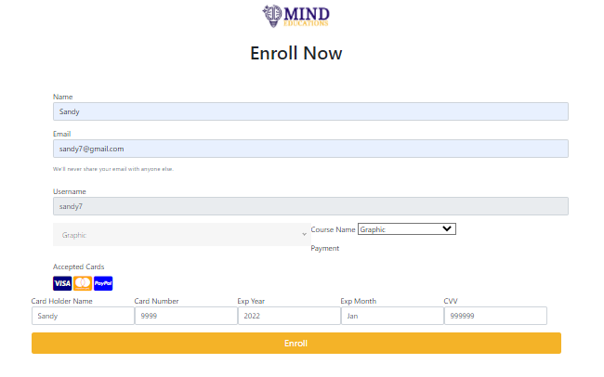
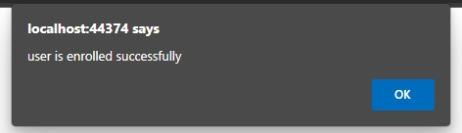
User Guidance

Slide 14

Conclusion
Educational platform for learners
Used concept of HTML,CSS,JS,Bootstrap & C#
Implementation of web form with validation
Online tutors to help users
Video conference with lecturer
Introduce online community for user interaction

Slide 15

THANK YOU !

